Slide 1
Hydraulic stimulation strategies in enhanced geothermal systems (EGS): a review
Dr. AB Dillas
Institute of Geosciences and Earth Resources Sri Lanka

Slide 2
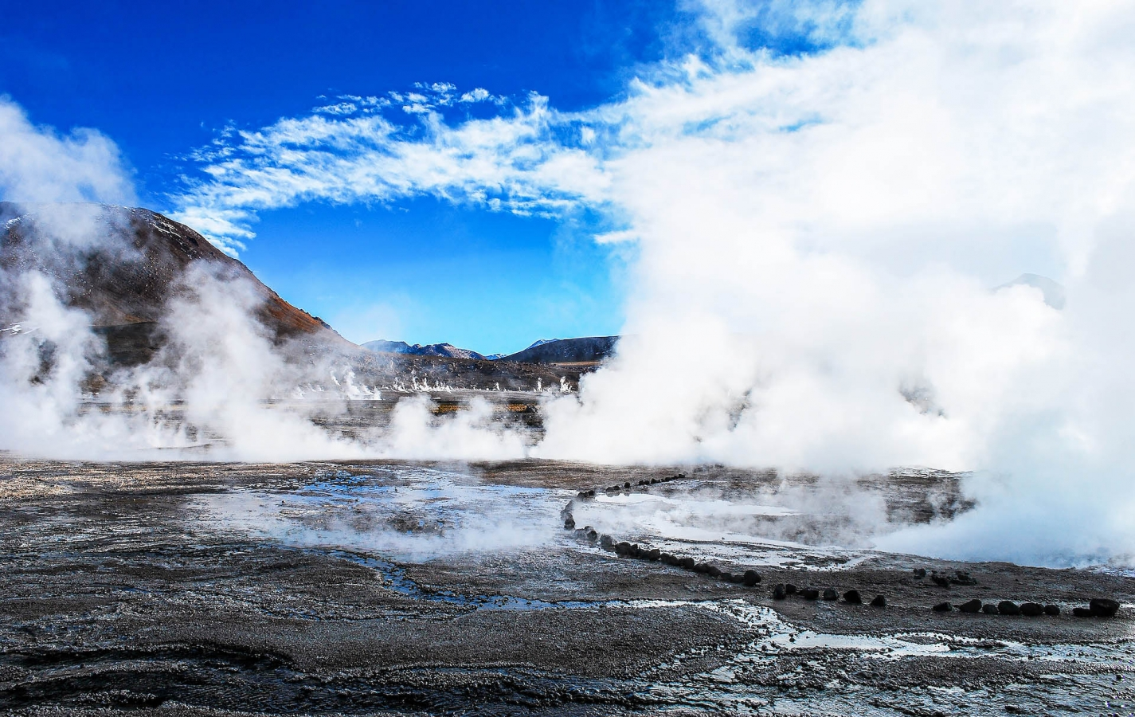
Geothermal Field
Geothermal fields, as opposed to hydrocarbon fields, are generally systems with a continuous circulation of heat and fluid, where fluid enters the reservoir from the recharge zones and leaves through discharge areas (hot springs, wells). During industrial exploitation, fluids are recharged to the reservoir by reinjecting the waste fluids from the utilization plants through wells. This reinjection process may compensate for at least part of the fluid extracted by the production and will to a certain extent prolong the commercial lifetime of the field. Geothermal energy is therefore to some extent a renewable energy source; however, the hot fluid production rates tend to be much larger than the recharge rates.

Slide 3
Beardsmore, G., Davidson, C., Payne, D., Pujol, M., and Ricard, L.: Australia Country Update, Proceedings World Geothermal Congress 2020, Reykjavik, Iceland, (2020).
Beate, B., Urquizo, M., and Lloret, A.,: Geothermal Country Update for Equador: 2015 -2020, Proceedings World Geothermal Congress 2020, Reykjavik, Iceland, (2020).
Bertani, R.: Geothermal Power Generation in the World 2010-2014 Update Report, Proceedings World Geothermal Congress 2015, Melbourne, Australia (2015)
Boissavy, C., Schmidle-Bloch, V., Pomart, A., and Lahlou, R.: Country Update France, Proceedings World Geothermal Congress 2020, Reykjavik, Iceland, (2020).
Carey, B, Daysh, S, Doorman, P, Luketina, K, White, B, and Zarrouk, S.: 2015 -2020 New Zealand Country Update, Proceedings, Proceedings World Geothermal Congress 2020, Reykjavik, Iceland, (2020).

Slide 4
Thank You

